Slide 1
Hi our names are atlanta and rihihana this is our research about commonwealth games

Slide 2
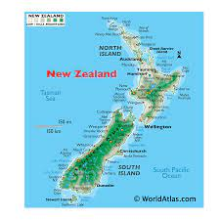
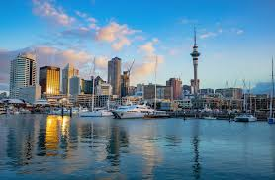
Commonwealth games snapshot.
Our commonwealth country is: New zealand

Slide 3
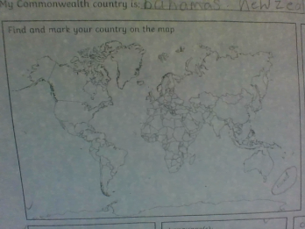
This is our country were researching about .
New zealand

Slide 4
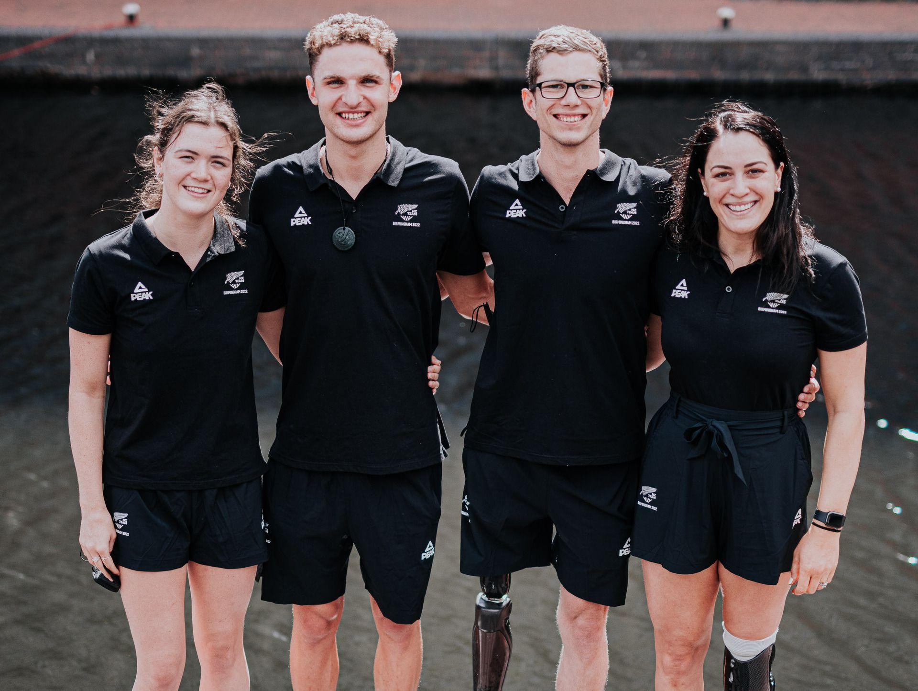
This is one of the commonwealth games uniform in nz.

Slide 5
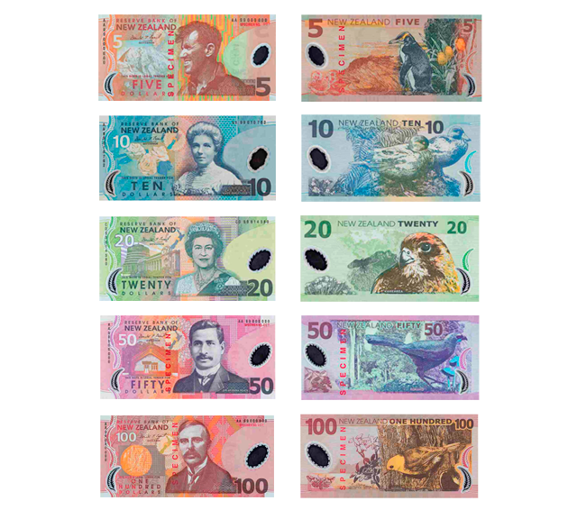
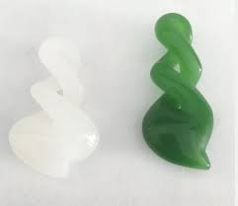
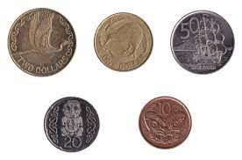
This is the size of our population:5.1 million
This is the languages:english,maori.
The currency used 5$ = brown, 20$=green ,100$=red , 50$=purple , 10$= blue
Coins color is : gold ,silver, and bronze,
Our currency in nz is called : notes coins and cents

Slide 6
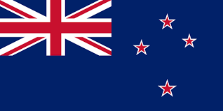
This is the new zealand flag.

Slide 7
Commonwealth games history.
They first entered the games in 1931 at the westminster commonwealth games . their most successful commonwealth game was in 2022 when they lifted nzs to 19 gold's two more than prevost best from auckland 1990.

Slide 8
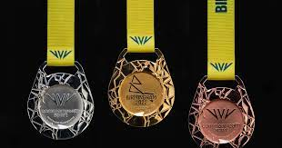
Medal history.
First medal was in 1992
Our latest medal :was in 2021,2022
Total medals: ,656
Bronze medals: 51
Silver medals: 33
Gold medals: 53

Slide 9
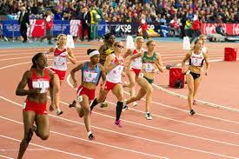
National anthem. Aotearoa God defend new zealand
Successful athletes.
: Jack lovelock
:Murray hallberg
:Peter snell
:Danyon loader
:Sarah umer

Slide 10
Here are some interesting facts.
:The first games were held in Canada in 1930
:It used to be known as the British Empire Games. ...
:The Commonwealth Games is being held in Birmingham in 2022! ...
:All people taking part have to be amateurs! ...
:The Commonwealth is a group of countries that used to be a part of the British Empire.

